Slide 1
Essential Calculus and Optimization for ML
CSN-382

Slide 2
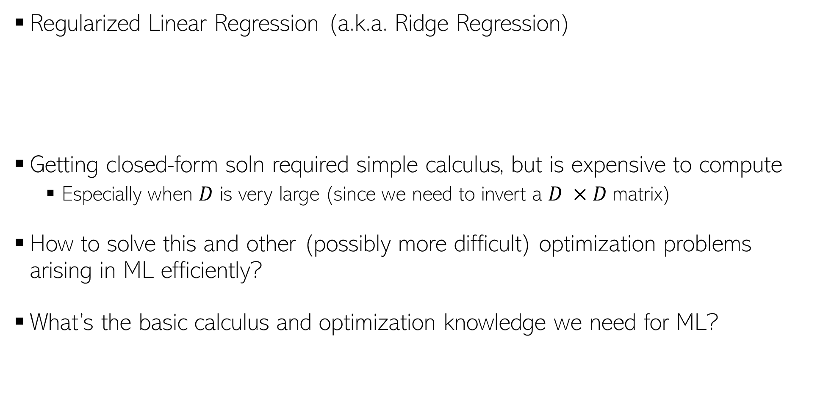
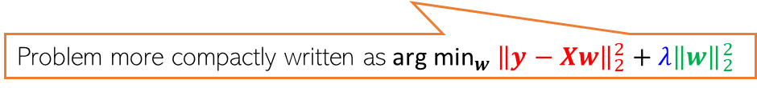
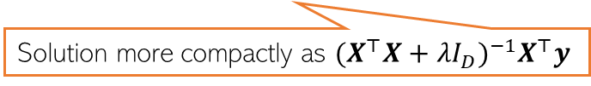
Calculus and Optimization for ML
2
Regularized Linear Regression (a.k.a. Ridge Regression)
Getting closed-form soln required simple calculus, but is expensive to compute
Especially when $D$ is very large (since we need to invert a $D ×D$matrix)
How to solve this and other (possibly more difficult) optimization problems arising in ML efficiently?
What’s the basic calculus and optimization knowledge we need for ML?
$w_{ridge}\text{=}{ \text{arg} \text{min}}_{w}\sum_{n=1}^{N}{{(y_{n}−w^{⊤}x_{n})}^{2}}+λw^{⊤}w={\left(\sum_{n=1}^{N}{x_{n} x_{n}^{⊤}+λI_{D} }\right)}^{−1}$ $(\sum_{n=1}^{N}{y_{n}}x_{n})$
Problem more compactly written as${ \text{arg} \text{min}}_{w} {\left\|y−Xw\right\|}_{2}^{2}+λ{\left\|w\right\|}_{2}^{2}$
Solution more compactly as ${(X^{⊤}X+λI_{D})}^{−1}X^{⊤}y$

Slide 3




Functions and their optima
The objective function of the ML problem we are solving (e.g., squared loss for regression)
Assume unconstrained for now, i.e., just a real-valued number/vector
Many ML problems require us to optimize a function $f$ of some variable(s) $x$
For simplicity, assume $f$ is a scalar-valued function of a scalar $x$($f:$ $ℝ →ℝ)$
Any function has one/more optima (maxima, minima), and maybe saddle points
Finding the optima or saddles requires derivatives/gradients of the function
$$f(x)$$
A local maxima
A local maxima
Global maxima
Usually interested in global optima but often want to find local optima, too
A local minima
For deep learning models, often the local optima are what we can find (and they usually suffice) – more later
A local minima
A local minima
$$x$$
Will see what these are later
Global minima

Slide 4
Extrema
Since we always seek the “best” values of a function, usually we are looking for the maxima or the minima of a function
Global extrema: a point which achieves the best value of the function (max/min) among all the possible points
Local extrema: a point which achieves the best value of the function only in a small region surrounding that point

Slide 5

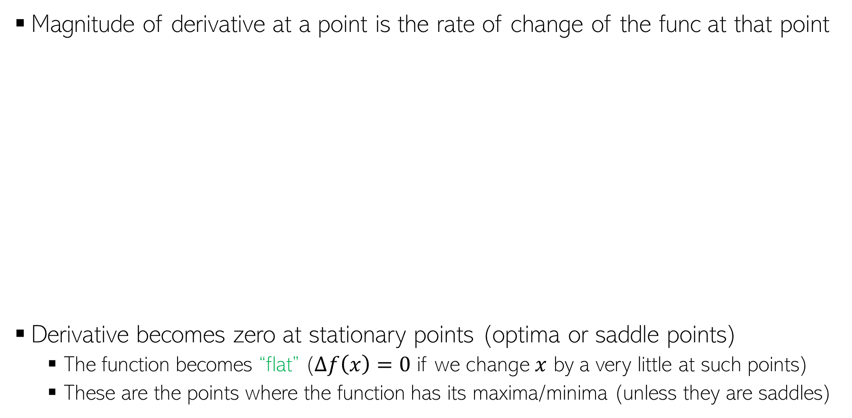

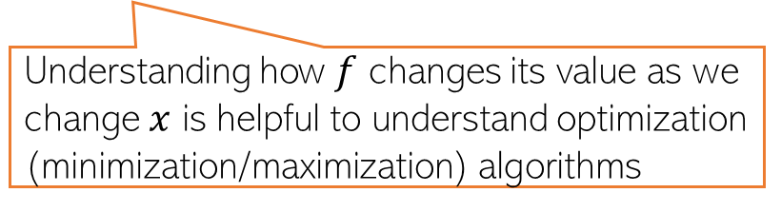

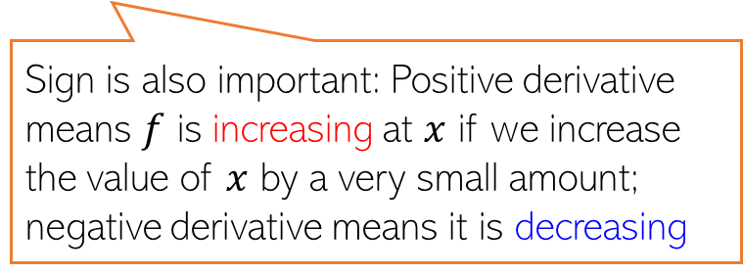


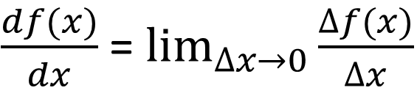


Derivatives
Will sometimes use $f^{′}(x)$ to denote the derivative
Magnitude of derivative at a point is the rate of change of the func at that point
Derivative becomes zero at stationary points (optima or saddle points)
The function becomes “flat” ($∆f\left(x\right)=0$ if we change $x$ by a very little at such points)
These are the points where the function has its maxima/minima (unless they are saddles)
$\frac{df(x)}{dx}$ = $\lim_{∆x→0}{\frac{∆f(x)}{∆x}}$
$$f(x)$$
Sign is also important: Positive derivative means $f$ is increasing at $x$ if we increase the value of $x$ by a very small amount; negative derivative means it is decreasing
$$∆f(x)$$
$$∆f(x)$$
$$∆x$$
$$∆x$$
$$x$$
Understanding how $f$ changes its value as we change $x$ is helpful to understand optimization (minimization/maximization) algorithms

Slide 6




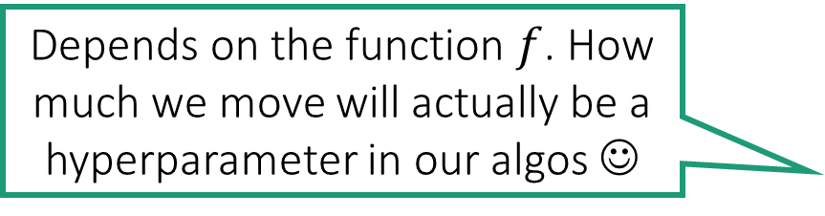

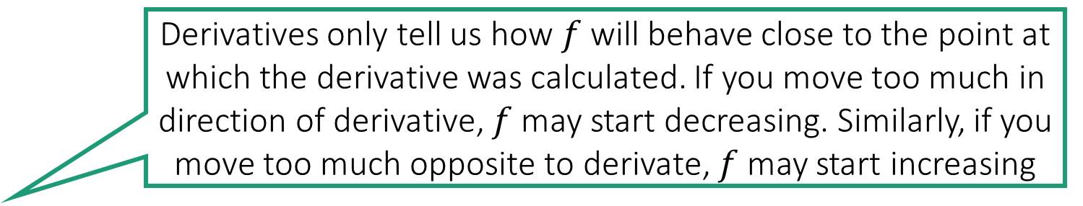

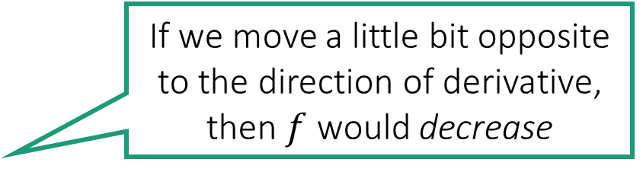


Derivatives
Derivatives only tell us how $f$ will behave close to the point at which the derivative was calculated. If you move too much in direction of derivative, $f$ may start decreasing. Similarly, if you move too much opposite to derivate, $f$ may start increasing
For a function $f:ℝ→ℝ$, the sign of its derivative at any point tells us whether we should move left or right on the number line to increase $f$.
If sign is positive, we should move right else left
Magnitude of the derivative tells us how steeply would $f$ increase if we moved a teeny tiny bit according to the derivative
If we move a little bit opposite to the direction of derivative, then $f$ would decrease
Depends on the function $f$. How much we move will actually be a hyperparameter in our algos ☺
$$Δf$$
What if I moved in the opposite direction of the derivative?
$$Δx$$
$$Δx$$
$$Δf$$

Slide 7
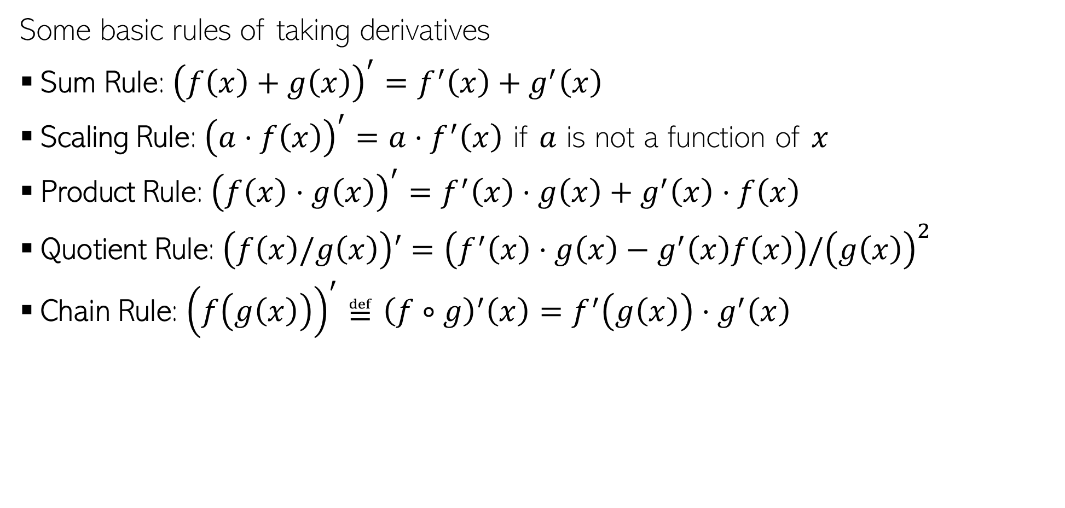
Rules of Derivatives
Some basic rules of taking derivatives
Sum Rule: ${\left(f\left(x\right)+g\left(x\right)\right)}^{′}=f^{′}\left(x\right)+g^{′}\left(x\right)$
Scaling Rule: ${\left(a⋅f\left(x\right)\right)}^{′}=a⋅f^{′}\left(x\right)$ if $a$ is not a function of $x$
Product Rule: ${\left(f\left(x\right)⋅g\left(x\right)\right)}^{′}=f^{′}\left(x\right)⋅g\left(x\right)+g^{′}\left(x\right)⋅f\left(x\right)$
Quotient Rule: $\left(f\left(x\right)/g\left(x\right)\right)′=\left(f^{′}\left(x\right)⋅g\left(x\right)−g^{′}\left(x\right)f\left(x\right)\right)/{\left(g\left(x\right)\right)}^{2}$
Chain Rule: ${\left(f\left(g\left(x\right)\right)\right)}^{′}≝{\left(f∘g\right)}^{′}\left(x\right)=f^{′}\left(g\left(x\right)\right)⋅g^{′}\left(x\right)$
We already used some of these (sum, scaling and chain) when calculating the derivative for the linear regression model

Slide 8
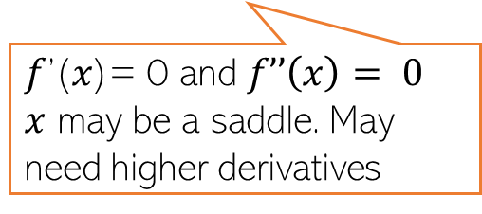
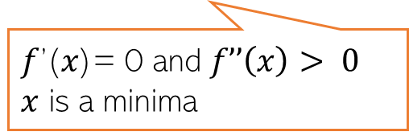
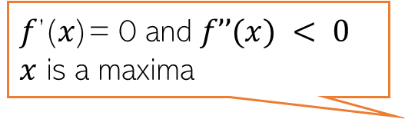

Derivatives
How the derivative itself changes tells us about the function’s optima
The second derivative $f’’(x)$can provide this information
𝑓’(𝑥)= 0 and $f’’(x) < 0$
$x$ is a maxima
𝑓’(𝑥)= 0 at 𝑥
𝑓’(𝑥)= 0 just before 𝑥 𝑓’(𝑥)= 0 just after 𝑥
𝑥 may be a saddle
𝑓’(𝑥)= 0 at 𝑥, 𝑓’(𝑥)>0 just before 𝑥 𝑓’(𝑥)<0 just after 𝑥
𝑥 is a maxima
𝑓’(𝑥)= 0 and $f’’\left(x\right)> 0$
$x$ is a minima
𝑓’(𝑥)= 0 and $f’’\left(x\right)= 0$
$x$ may be a saddle. May need higher derivatives
𝑓’(𝑥)= 0 at 𝑥
𝑓’(𝑥)< 0 just before 𝑥 𝑓’(𝑥)>0 just after 𝑥
𝑥 is a minima

Slide 9
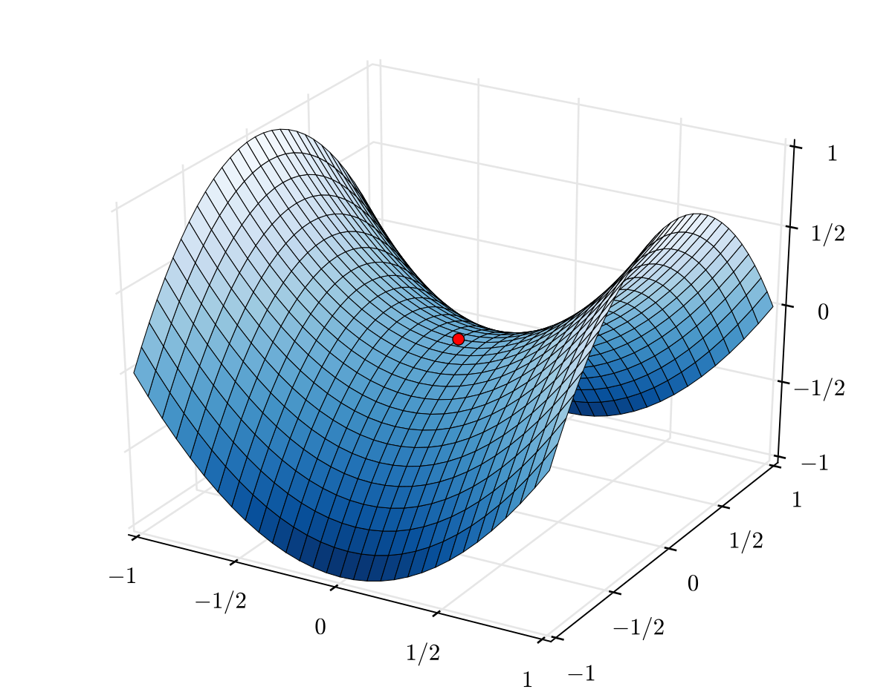
Saddle Points
Points where derivative is zero but are neither minima nor maxima
Saddle points are very common for loss functions of deep learning models
Need to be handled carefully during optimization
Second or higher derivative may help identify if a stationary point is a saddle
A saddle point
Saddle is a point of inflection where the derivative is also zero

Slide 10
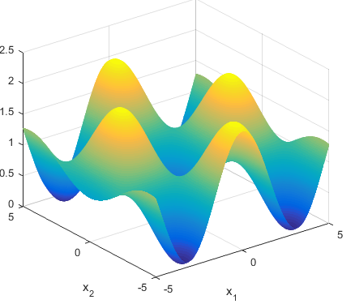

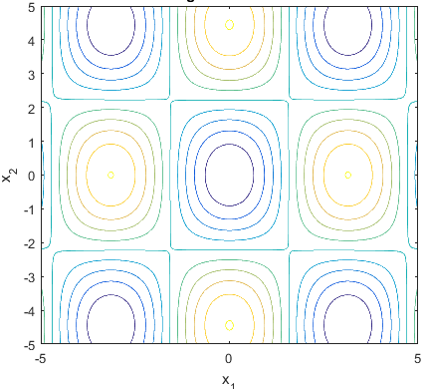

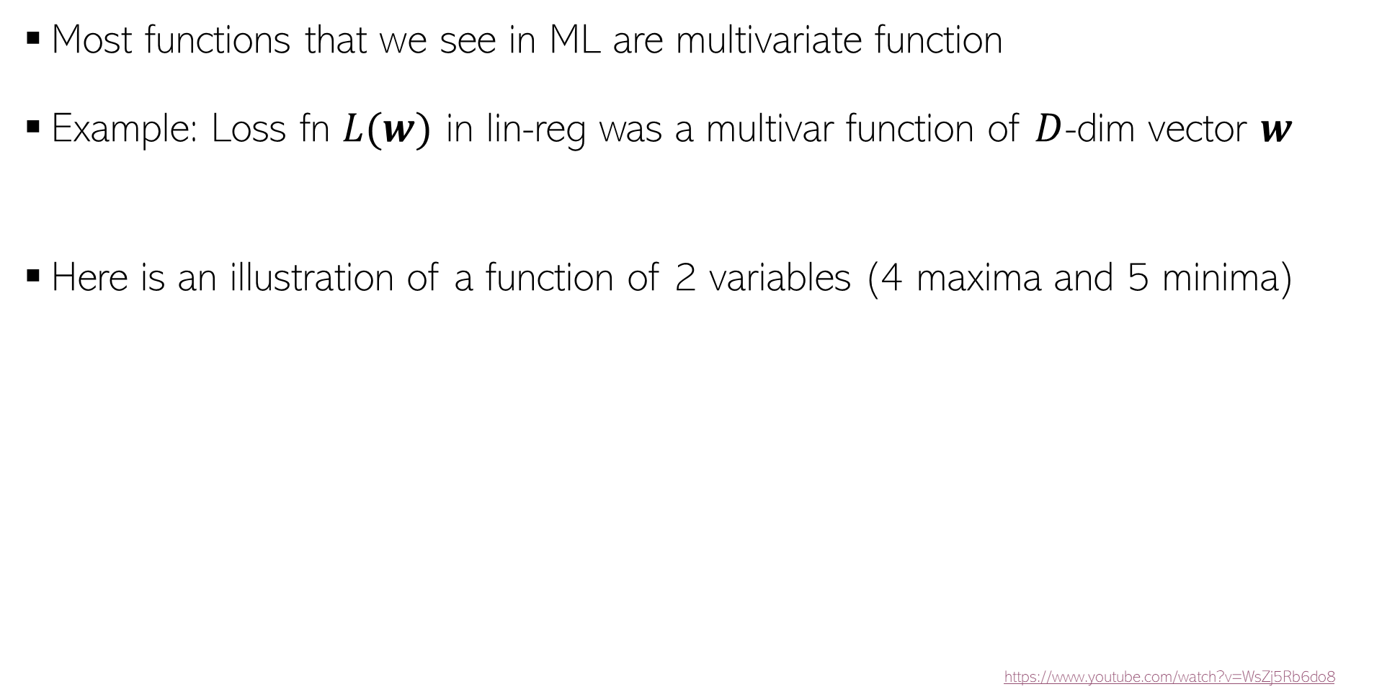
Multivariate Functions
Most functions that we see in ML are multivariate function
Example: Loss fn $L(w)$ in lin-reg was a multivar function of $D$-dim vector $w$
Here is an illustration of a function of 2 variables (4 maxima and 5 minima)
https://www.youtube.com/watch?v=WsZj5Rb6do8
$L\left(w\right):ℝ^{D}$ $→ℝ$
Two-dim contour plot of the function (i.e., what it looks like from the above)
Plot courtesy: http://benchmarkfcns.xyz/benchmarkfcns/griewankfcn.html

Slide 11
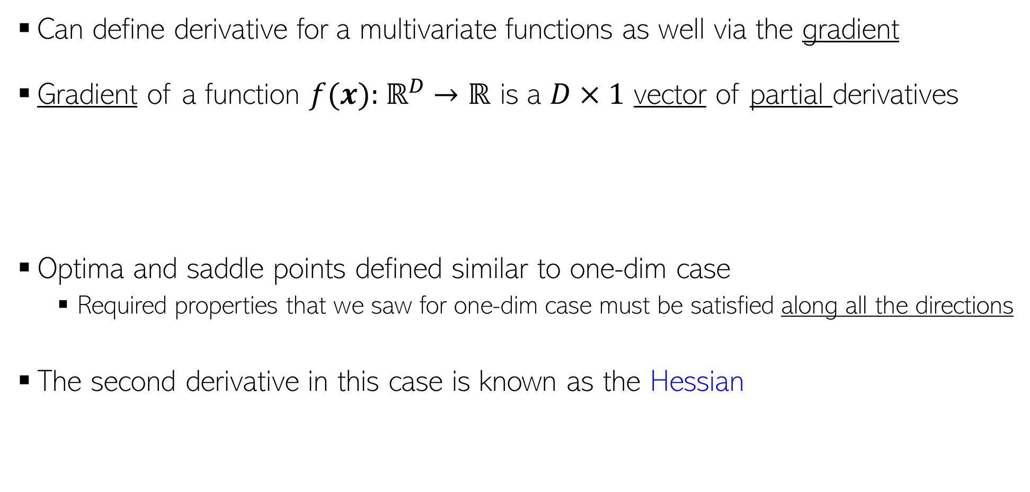
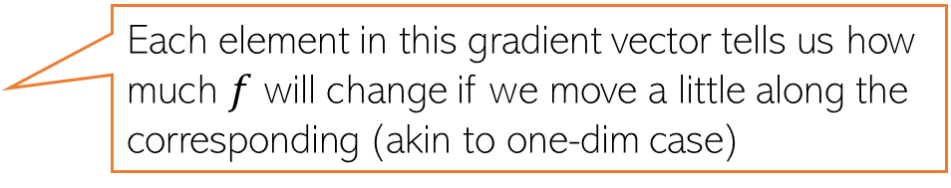
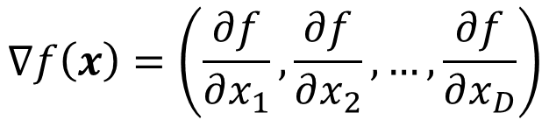
Derivatives of Multivariate Functions
Can define derivative for a multivariate functions as well via the gradient
Gradient of a function $f(x):$ $ℝ^{D}$ $→ℝ$ is a $D×1$ vector of partial derivatives
Optima and saddle points defined similar to one-dim case
Required properties that we saw for one-dim case must be satisfied along all the directions
The second derivative in this case is known as the Hessian
$$∇f\left(x\right)=\left(\frac{∂f}{∂x_{1}},\frac{∂f}{∂x_{2}},…,\frac{∂f}{∂x_{D}}\right)$$
Each element in this gradient vector tells us how much $f$ will change if we move a little along the corresponding (akin to one-dim case)

Slide 12

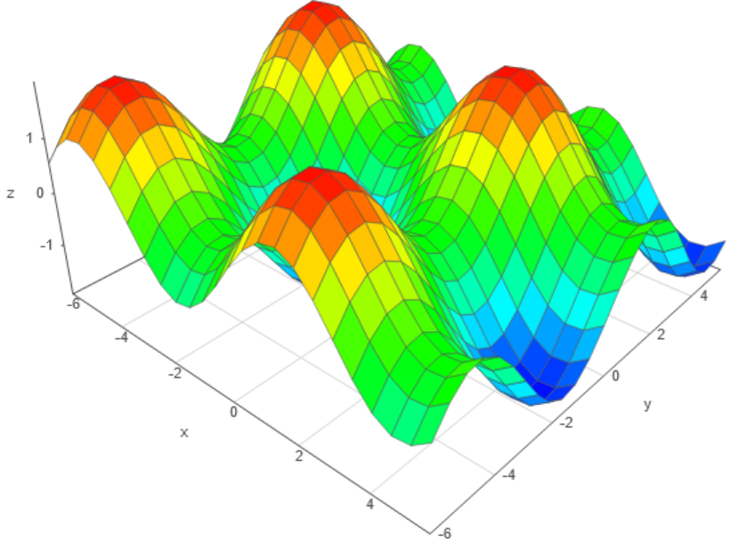
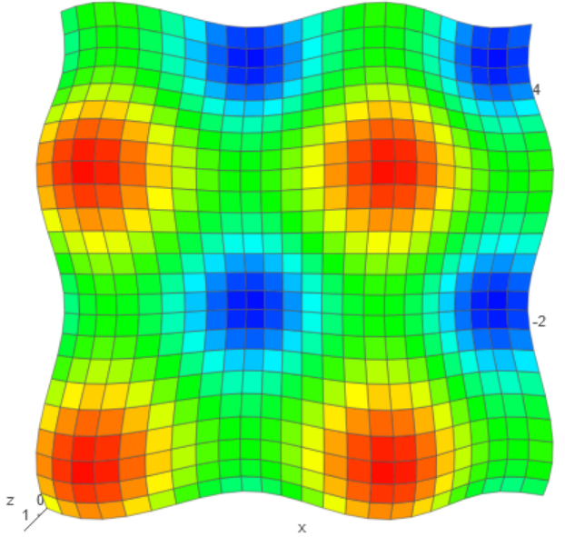


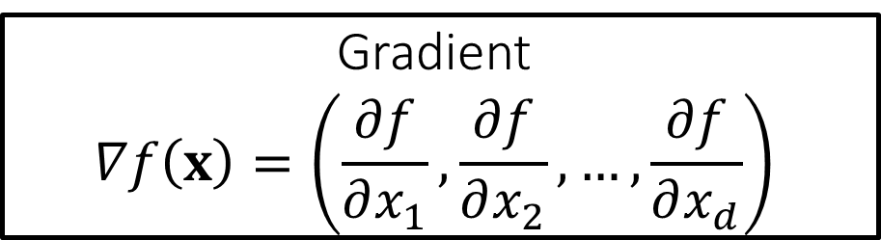


Multivariate Functions $f:ℝ^{d}→ℝ$
This looks just like the 1D case except that we are summing up contributions from all $d$ dimensions
Gradient $$∇f\left(x\right)=\left(\frac{∂f}{∂x_{1}},\frac{∂f}{∂x_{2}},…,\frac{∂f}{∂x_{d}}\right)$$
The gradient also has the distinction of offering the steepest ascent i.e. if we want maximum increase in function value, we must move a little bit along the gradient. Similarly, we must move a little bit in the direction opposite to gradient to get the maximum decrease in the function value, i.e. the gradient also offers us the steepest descent
Saddle
Local min
For multivariate functions with $d$-dim inputs, the gradient simply records how much the function would change if we move a little bit along each one of the $d$ axes!
Local max

Slide 13
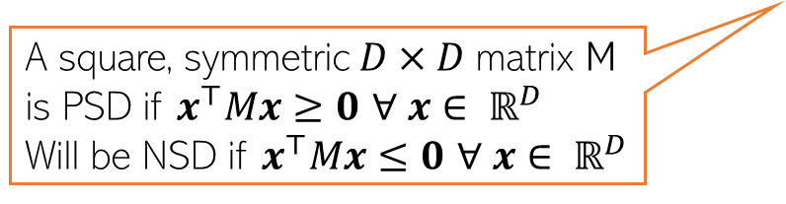

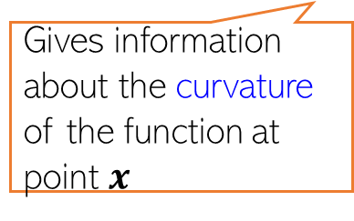


The Hessian
For a multivar scalar valued function $f(x):$ $ℝ^{D}$ $→ℝ$, Hessian is a $D× D$matrix
The Hessian matrix can be used to assess the optima/saddle points
$∇f\left(x\right)$ = 0 and $∇^{2}f\left(x\right)$ is a positive semi-definite (PSD) matrix then $x$ is a minima
$∇f\left(x\right)$ = 0, and $∇^{2}f\left(x\right)$ is a negative semi-definite (NSD) matrix then $x$ is a maxima
Note: If the function itself is vector valued, e.g., $f(x):$ $ℝ^{D}$ $→ℝ^{K}$ then we will have $K$ such $D× D$Hessian matrices, one for each output dimension of $f$
$$∇^{2}f\left(x\right)=\left[\begin{matrix}\begin{aligned}\frac{∂^{2}f}{∂x_{1}^{2}} \\ \frac{∂^{2}f}{∂x_{2}x_{1}}\end{aligned} & \begin{aligned}\frac{∂^{2}f}{∂x_{1}x_{2}} \\ \frac{∂^{2}f}{∂x_{2}^{2}}\end{aligned} & \begin{aligned}… \\ …\end{aligned} \\ ⋮ & ⋮ & ⋱ \\ \frac{∂^{2}f}{∂x_{D}x_{1}} & \frac{∂^{2}f}{∂x_{D}x_{2}} & …\end{matrix} \begin{matrix}\frac{∂^{2}f}{∂x_{1}x_{D}} \\ \frac{∂^{2}f}{∂x_{2}x_{D}} \\ \begin{aligned}⋮ \\ \frac{∂^{2}f}{∂x_{D}^{2}}\end{aligned}\end{matrix}\right]$$
Gives information about the curvature of the function at point $x$
A square, symmetric $D×D$matrix M is PSD if $x^{⊤}Mx≥0$ $∀ x∈ ℝ^{D}$
Will be NSD if $x^{⊤}Mx≤0$ $∀ x∈ ℝ^{D}$
PSD if all eigenvalues are non-negative

Slide 14
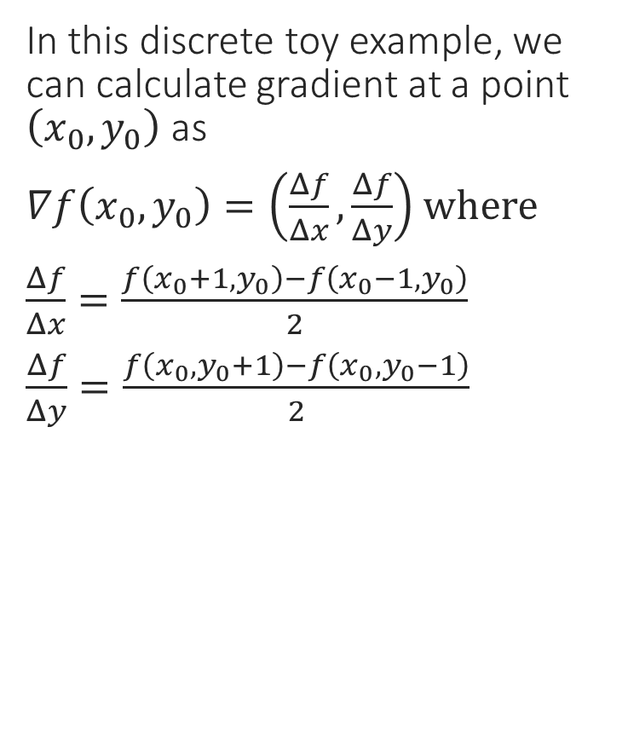
A Toy Example – Function Values
In this discrete toy example, we can calculate gradient at a point $\left(x_{0},y_{0}\right)$ as
$∇f\left(x_{0},y_{0}\right)=\left(\frac{Δf}{Δx},\frac{Δf}{Δy}\right)$ where
$\frac{Δf}{Δx}=\frac{f\left(x_{0}+1,y_{0}\right)−f\left(x_{0}−1,y_{0}\right)}{2}$
$\frac{Δf}{Δy}=\frac{f\left(x_{0},y_{0}+1\right)−f\left(x_{0},y_{0}−1\right)}{2}$
3 | 3 | 3 | 3 | 3 | 3 | 3 | 3 | 3
2 | 2 | 2 | 3 | 4 | 3 | 3 | 2 | 1
1 | 1 | 1 | 3 | 3 | 3 | 1 | 1 | 1
1 | 0 | 1 | 1 | 2 | 1 | 1 | 0 | 1
1 | 1 | 1 | 3 | 3 | 3 | 1 | 1 | 1
1 | 2 | 3 | 3 | 4 | 3 | 2 | 2 | 2
3 | 3 | 3 | 3 | 3 | 3 | 3 | 3 | 3
0 1 2 3 4 5 6
0 1 2 3 4 5 6 7 8

Slide 15
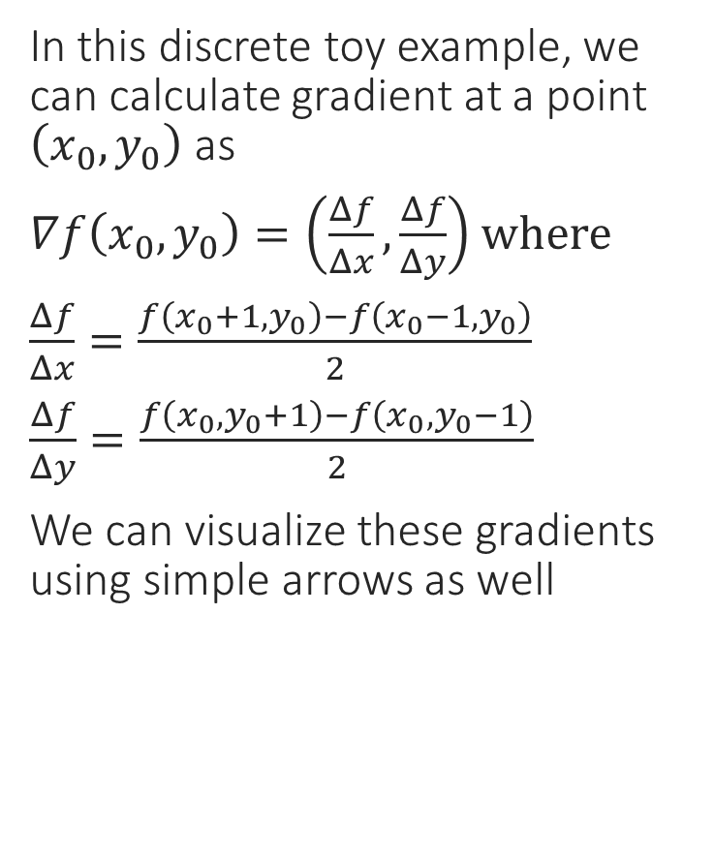
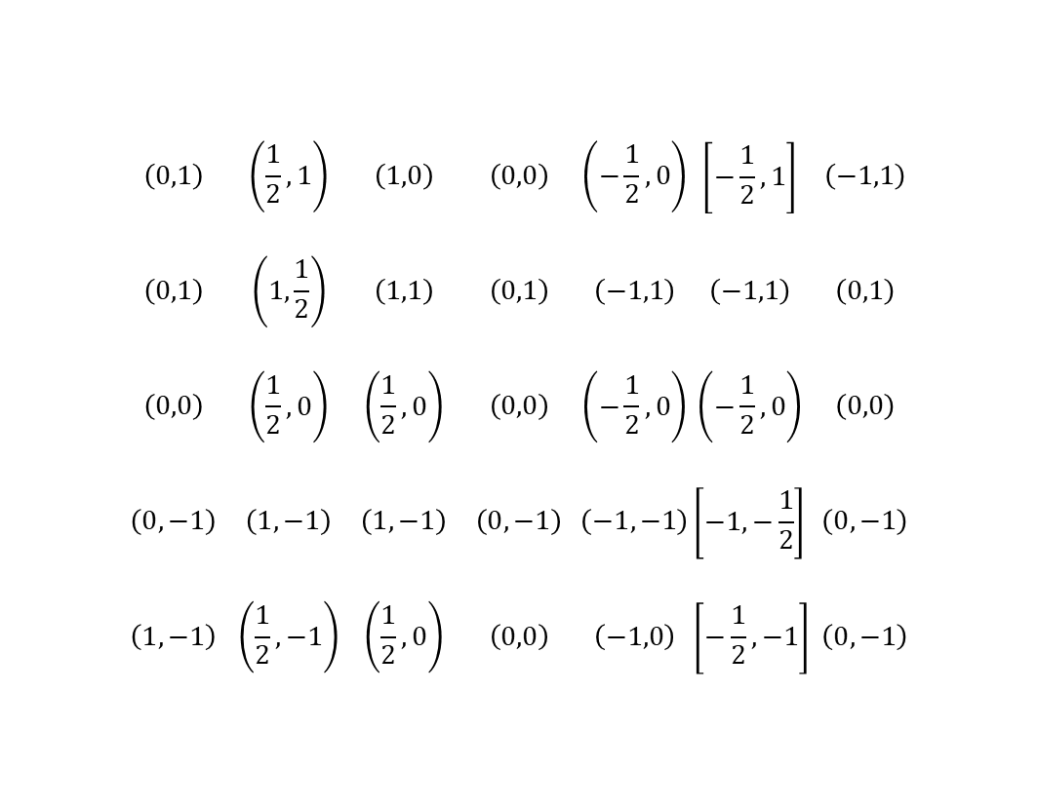
A Toy Example – Gradients
In this discrete toy example, we can calculate gradient at a point $\left(x_{0},y_{0}\right)$ as
$∇f\left(x_{0},y_{0}\right)=\left(\frac{Δf}{Δx},\frac{Δf}{Δy}\right)$ where
$\frac{Δf}{Δx}=\frac{f\left(x_{0}+1,y_{0}\right)−f\left(x_{0}−1,y_{0}\right)}{2}$
$\frac{Δf}{Δy}=\frac{f\left(x_{0},y_{0}+1\right)−f\left(x_{0},y_{0}−1\right)}{2}$
We can visualize these gradients using simple arrows as well
 | $$\left(0,1\right)$$ | $$\left(\frac{1}{2},1\right)$$ | $$\left(1,0\right)$$ | $$\left(0,0\right)$$ | $$\left(−\frac{1}{2},0\right)$$ | $$\left[−\frac{1}{2},1\right]$$ | $$\left(−1,1\right)$$
 | $$\left(0,1\right)$$ | $$\left(1,\frac{1}{2}\right)$$ | $$\left(1,1\right)$$ | $$\left(0,1\right)$$ | $$\left(−1,1\right)$$ | $$\left(−1,1\right)$$ | $$\left(0,1\right)$$
 | $$\left(0,0\right)$$ | $$\left(\frac{1}{2},0\right)$$ | $$\left(\frac{1}{2},0\right)$$ | $$\left(0,0\right)$$ | $$\left(−\frac{1}{2},0\right)$$ | $$\left(−\frac{1}{2},0\right)$$ | $$\left(0,0\right)$$
 | $$\left(0,−1\right)$$ | $$\left(1,−1\right)$$ | $$\left(1,−1\right)$$ | $$\left(0,−1\right)$$ | $$\left(−1,−1\right)$$ | $$\left[−1,−\frac{1}{2}\right]$$ | $$\left(0,−1\right)$$
 | $$\left(1,−1\right)$$ | $$\left(\frac{1}{2},−1\right)$$ | $$\left(\frac{1}{2},0\right)$$ | $$\left(0,0\right)$$ | $$\left(−1,0\right)$$ | $$\left[−\frac{1}{2},−1\right]$$ | $$\left(0,−1\right)$$
Saddle
Local min
0 1 2 3 4 5 6
Local max
0 1 2 3 4 5 6 7 8

Slide 16
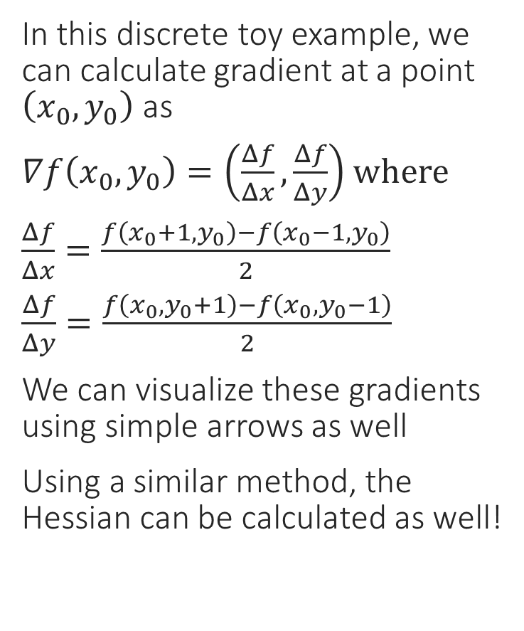
A Toy Example – Gradients
Gradients converge toward local max
In this discrete toy example, we can calculate gradient at a point $\left(x_{0},y_{0}\right)$ as
$∇f\left(x_{0},y_{0}\right)=\left(\frac{Δf}{Δx},\frac{Δf}{Δy}\right)$ where
$\frac{Δf}{Δx}=\frac{f\left(x_{0}+1,y_{0}\right)−f\left(x_{0}−1,y_{0}\right)}{2}$
$\frac{Δf}{Δy}=\frac{f\left(x_{0},y_{0}+1\right)−f\left(x_{0},y_{0}−1\right)}{2}$
We can visualize these gradients using simple arrows as well
Using a similar method, the Hessian can be calculated as well!
Gradients diverge away from local min
0 1 2 3 4 5 6
At saddle points, both can happen along different axes
0 1 2 3 4 5 6 7 8

Slide 17
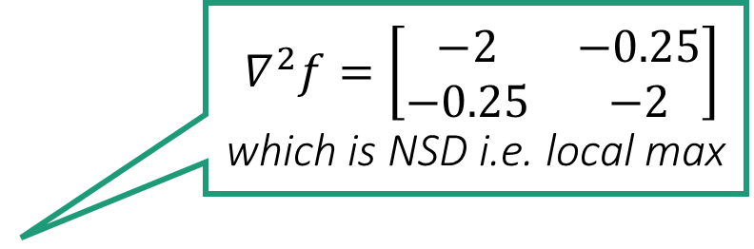

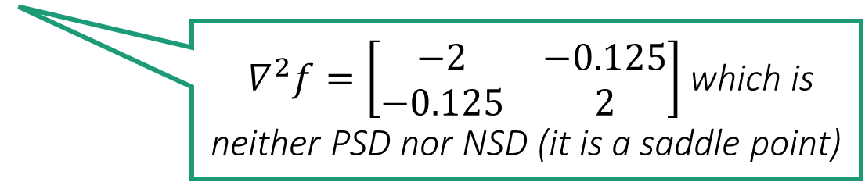
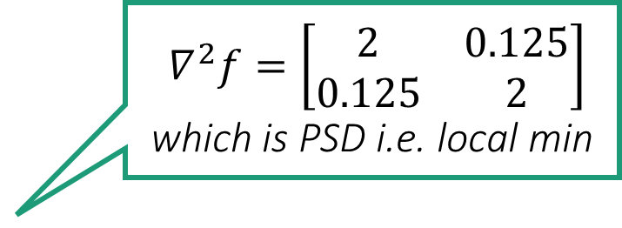
A Toy Example – Hessians
$∇^{2}f=\left[\begin{matrix}−2 & −0.25 \\ −0.25 & −2\end{matrix}\right]$ which is NSD i.e. local max
In this discrete toy example, we can calculate Hessian at $\left(x_{0},y_{0}\right)$ as
$∇^{2}f\left(x_{0},y_{0}\right)=\left[\begin{matrix}\frac{Δ^{2}f}{Δx^{2}} & \frac{Δ^{2}f}{ΔxΔy} \\ \frac{Δ^{2}f}{ΔxΔy} & \frac{Δ^{2}f}{Δy^{2}}\end{matrix}\right]$ where
$\frac{Δ^{2}f}{Δx^{2}}=f\left(x_{0}+1,y_{0}\right)+f\left(x_{0}−1,y_{0}\right)−2f\left(x_{0},y_{0}\right)$
$\frac{Δ^{2}f}{Δy^{2}}=f\left(x_{0},y_{0}+1\right)+f\left(x_{0},y_{0}−1\right)−2f\left(x_{0},y_{0}\right)$
$\frac{Δ^{2}f}{ΔxΔy}=\frac{\left(f_{xy}+f_{yx}\right)}{2}$ where
$f_{xy}=\frac{\frac{Δf}{Δx}\left(x_{0},y_{0}+1\right)−\frac{Δf}{Δx}\left(x_{0},y_{0}−1\right)}{2}$
$f_{yx}=\frac{\frac{Δf}{Δy}\left(x_{0}+1,y_{0}\right)−\frac{Δf}{Δy}\left(x_{0}−1,y_{0}\right)}{2}$
$∇^{2}f=\left[\begin{matrix}2 & 0.125 \\ 0.125 & 2\end{matrix}\right]$ which is PSD i.e. local min
0 1 2 3 4 5 6
$∇^{2}f=\left[\begin{matrix}−2 & −0.125 \\ −0.125 & 2\end{matrix}\right]$ which is neither PSD nor NSD (it is a saddle point)
0 1 2 3 4 5 6 7 8

Slide 18
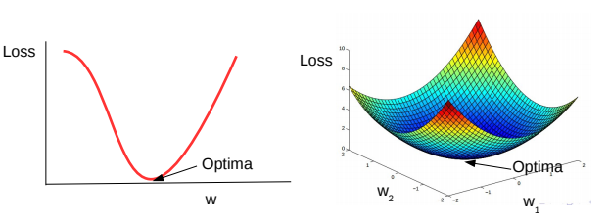
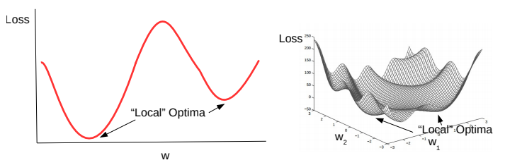
Convex and Non-Convex Functions
A function being optimized can be either convex or non-convex
Here are a couple of examples of convex functions
Here are a couple of examples of non-convex functions
Convex functions are bowl-shaped. They have a unique optima (minima)
Negative of a convex function is called a concave function, which also has a unique optima (maxima)
Non-convex functions have multiple minima. Usually harder to optimize as compared to convex functions
Loss functions of most deep learning models are non-convex

Slide 19
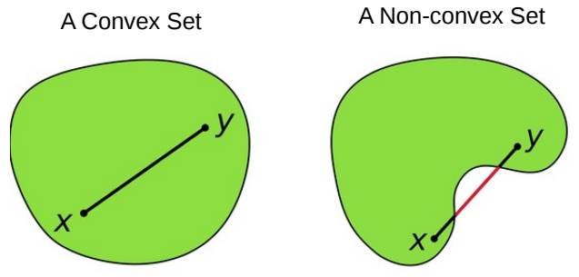
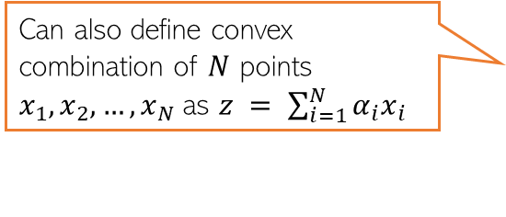



Convex Sets
A set S of points is a convex set, if for any two points $x, y ∈ S$, and 0 ≤ $α$ ≤ 1
Above means that all points on the line-segment between $x$ and $y$ lie within $S$
The domain of a convex function needs to be a convex set
$z$ is also called a “convex combination” of two points
Can also define convex combination of $N$ points $x_{1},x_{2},…,x_{N}$as $z = \sum_{i=1}^{N}{α_{i}x_{i}}$
$$z=αx+\left(1−α\right)y∈S$$

Slide 20


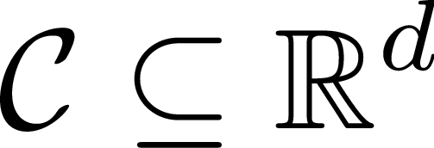

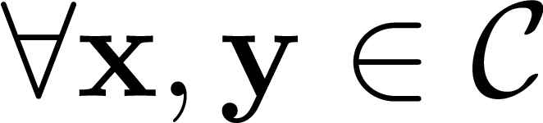
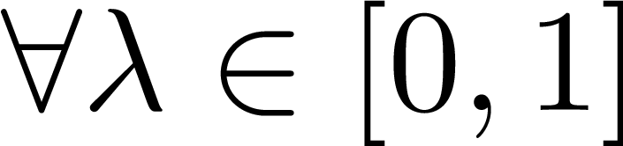
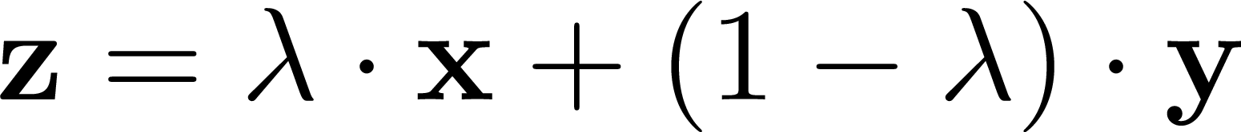

Convex Sets
CONVEX SET
NON-CONVEX SET
Think about which common shapes/objects are convex and which are not – balls, cuboids, stars, rectangles?
The intersection of two convex sets is always convex. The union may or may not be convex!

Slide 21
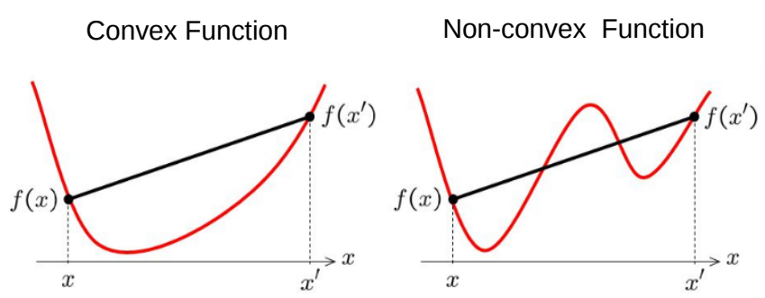



Convex Functions
Informally, $f(x)$ is convex if all of its chords lie above the function everywhere
Formally, (assuming differentiable function), some tests for convexity:
First-order convexity (graph of $f$ must be above all the tangents)
Second derivative a.k.a. Hessian (if exists) must be positive semi-definite
Exercise: Show that ridge regression objective is convex

Slide 22










Convex Functions
The tangent to $f$ at a point $x_{0}$ is the hyperplane $∇f{\left(x_{0}\right)}^{⊤}\left(x−x_{0}\right)+f\left(x_{0}\right)=0$
Think of common functions that are convex 1D examples: $x^{2}$
d-dim example: ${\left\|x\right\|}_{2}^{2}$
CONVEX FUNCTION
NON-CONVEX
FUNCTION
A differentiable convex function must lie above all its tangents
For differentiable functions, a nicer definition
The sum of two convex functions is always convex. The difference may or may not be convex
In fact a third definition exists for twice differentiable convex functions: their Hessian $∇^{2}f\left(x\right)$ must be PSD everywhere
A convex function must lie below all its chords

Slide 23



Checking for Convexity
Many popular functions are concave e.g. $\log{x}, \sqrt{x}$. The negative of a concave function is always convex
All constant functions $f\left(x\right)=c$ are convex
All linear functions $f\left(x\right)=a^{⊤}x$ are convex
Sums of convex functions are convex
Positive multiples of convex functions $c⋅f\left(x\right), c≥0$ are convex
If $g:ℝ^{d}→ℝ$ is convex and $f:ℝ→ℝ$ is convex and non-decreasing i.e. $a≥b⇒f\left(a\right)≥f\left(b\right)$, then $f∘g:ℝ^{d}→ℝ$ is convex
The Euclidean distance is convex $f\left(x\right)={\left\|x\right\|}_{2}$ is convex
If $f:ℝ→ℝ$ is convex then $g\left(x\right)=f\left(a^{⊤}x+b\right)$ is also convex
The negative of a convex function $−f\left(x\right)$ is called a concave function and they look like inverted cups
I also love concave functions since all local maxima are global maxima for a concave function
Convex functions look like cups
I love convex functions since all local minima are global minima for a convex function

Slide 24

Some Basic Rules for Convex Functions

Slide 25
Coming up next
Gradients when the function is non-differentiable
Solving optimization problems
Iterative optimization algorithms, such as gradient descent and its variants

